Slide 1
Fundamentals of Networks and Security
Vassilis Markos
Mediterranean College
Week 04

Slide 2
A Quick Revision

Slide 3
What we saw last time… 1 / n
What is the speed of light?
300,000 km/s
Name some drawbacks of using light as a means of messaging.
Some drawbacks are:
How can we convert messages to light?
Light beams cannot bend (but for gravitational lenses, but we are not studying theoretical physics at the moment…).
It has two states: visible (on) and not visible (off).
Security?

Slide 4
What we saw last time… 2 / n
Name the key parts of an optic fibre.
The core parts of an optic fibre are:
Core: Where the light travels.
Cladding: Surrounds the core to keep light there via “total internal reflection”.
Coating: Reinforces its internals, usually plastic.
Strengthening fibers: “Cushion” that protects the core against tensions.
Cable Jacket: More protection (from the environment, us etc).

Slide 5
What we saw last time…3 / n
Name some differences and similarities of mono- and multi-mode fibres.
Some similarities are:
Both can transmit messages to long distance and a high bandwidth.
They are fragile.
They are expensive to buy and install.
Some differences are:
Monomode fibres comprises of a single mode light, while multimode ones from multiple similar modes.
Monomode light is driven by expensive lasers compared to multimode.
Monomode light is hard to terminate while multimode is not.

Slide 6
What we saw last time… 4 / n
Having two copper cables close together may result to corrupt signals. How can we fix it?
By twisting cables together we manage to minimise RFI and EMI, thus minimising corrupt signals. Moreover, through twisting both cables are alternately coming closer to the signal source, thus further reducing the chance of RFI / EMI.
What is the difference between WAP and Wireless Router?
In general, routers of any type make a network visible to other networks, while AP make “the local network” visible to other clients within the same network.

Slide 7
What we saw last time… 5 / n
Name some types of networks.
Some types of networks include:
PAN: Personal Area Network
LAN: Local Area Network
WLAN: Wireless LAN
SAN: Storage Area Network
MAN: Metropolitan Area Network
WAN: Wide Area Network
Wireless variants of the above…

Slide 8
Layers

Slide 9
Would you like some coffee?
Dissect the process of asking for coffee at the queue of a coffee shop:
“I would like some coffee”
“We have [list of complex coffee types I don’t understand]”
“Okay, it is 1.50 €”
“Fine”
[Makes coffee for us]
“Here you are”
[We get our coffee and pay]

Slide 10
Layers of coffee buying
Dissect the process of asking for coffee at the queue of a coffee shop:
“I would like some coffee” ← Client Request
“We have [list of complex coffee types I don’t understand]” ← Confirmation
“Okay, it is 1.50 €” ← Cost suggestion
“Fine” ← Price Agreement
[Makes coffee for us] ← Service provision
“Here you are” ← Service provision
[We get our coffee and pay] ← Accept, Completion Confirmation, Acceptance Confirmation

Slide 11
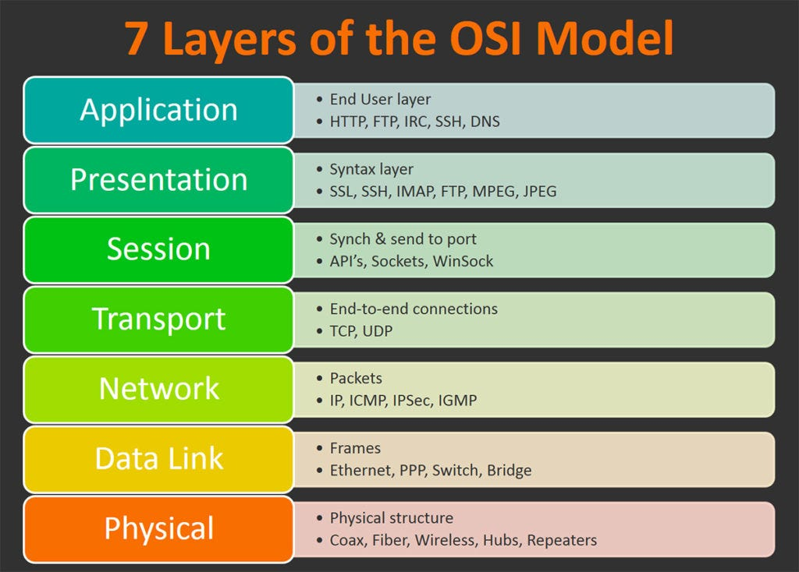
Open Systems Interconnection (OSI)
The top 4 layers are the Host Layers.
The bottom 3 layers are the Media Layers.
Sometimes, we split the 2nd layer (Data Link) to two sublayers: LLC and MAC.
Borrowed from: https://int0x33.medium.com/day-51-understanding-the-osi-model-f22d5f3df756

Slide 12
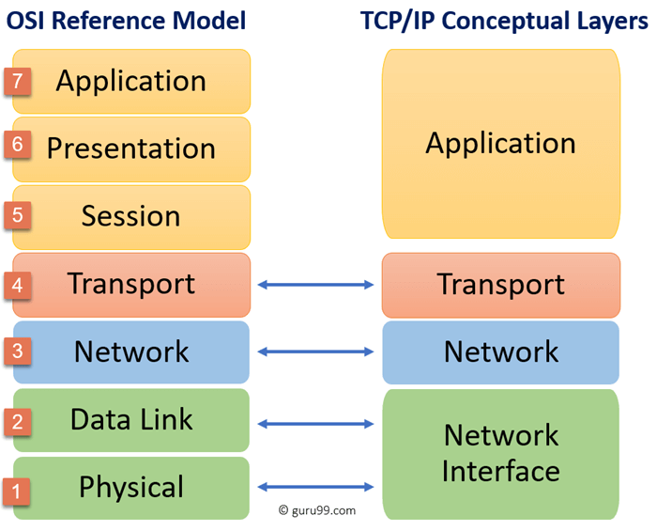
TCP/IP 4 Layer Model
More compact / abstract view of the same things.
Useful when abstraction is needed (e.g., to get a higher level view).
Useless when lower level information is needed (e.g., to design a network).
Borrowed from:
https://www.guru99.com/tcp-ip-model.html

Slide 13
Why use Models?
Global representation of multiple, highly diverse systems.
Facilitates understanding of networks and similar concepts.
The core processes are predetermined. We don’t have to worry about them (at an abstract level).
We need to take care of how information flows across layers (i.e., how the information flow across processes).

Slide 14
Coffee Encapsulation
Concept: Thirst (or need for coffee).
Data: “I want coffee”
“Cost will be 3.50 €”
“I agree to the price”
Coffee is then prepared
“Cost will be 3.50 €”
Payment is then provided
“I want coffee”
Coffee is served.
Concept is satisfied

Slide 15
Coffee Encapsulation
Concept: Thirst (or need for coffee).
Data: “I want coffee” (Why?)
“Cost will be 3.50 €” (Cost of what?)
“I agree to the price” (To what do I agree?)
Coffee is then prepared
“Cost will be 3.50 €” (Cost of what?)
Payment is then provided
“I want coffee” (Why?)
Coffee is served.
Concept is satisfied

Slide 16
Coffee Encapsulation
Concept: Thirst (or need for coffee).
Data: “I want coffee” (Why?) (Thirst)
“Cost will be 3.50 €” (Cost of what?) (Of the coffee)
“I agree to the price” (To what do I agree?) (To the cost of 3.50€ (of the coffee))
Coffee is then prepared
“Cost will be 3.50 €” (Cost of what?) (Of the coffee)
Payment is then provided
“I want coffee” (Why?) (Thirst)
Coffee is served.
Concept is satisfied

Slide 17
Encapsulation in Networks
Information is added incrementally, as we move “downwards” through the layers, i.e., from the more abstract to the more lower-level layers. This process is called encapsulation.
Original information is wrapped in enabling information (i.e., “headers”).
Moving backwards, from lower- to higher-level layers, we make use of and strip off the enabling information, thus efficiently getting back the original data.
The above process is called decapsulation.

Slide 18
Why Encapsulation?
Simpler interactions.
No need for layers to “understand” each other.
Each layer only sees data from above layers.
So, assuming that we know at which layer we are (e.g., layer 3) we need not show the content of a Protocol Data Unit (PDU) from a layer above, since our current layer “sees” data from above.

Slide 19
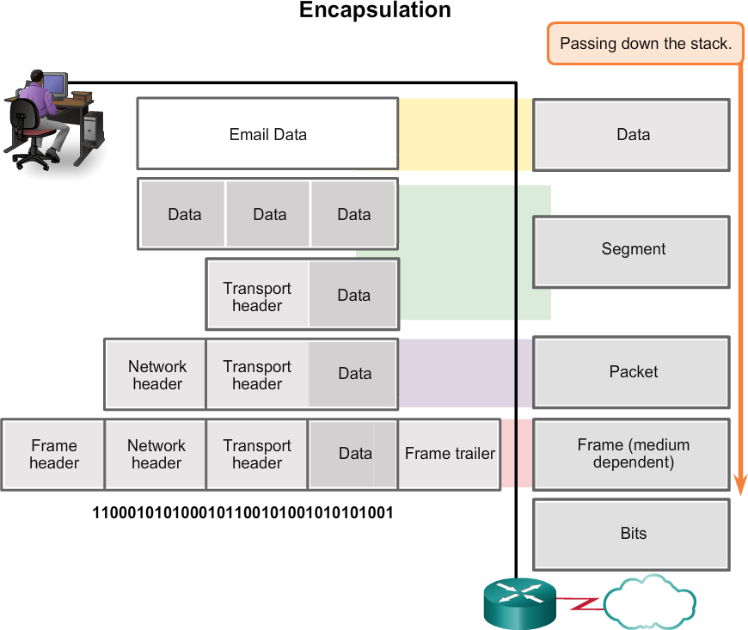
PDUs
Each PDU at a certain layer carries information about layers above it.

Slide 20
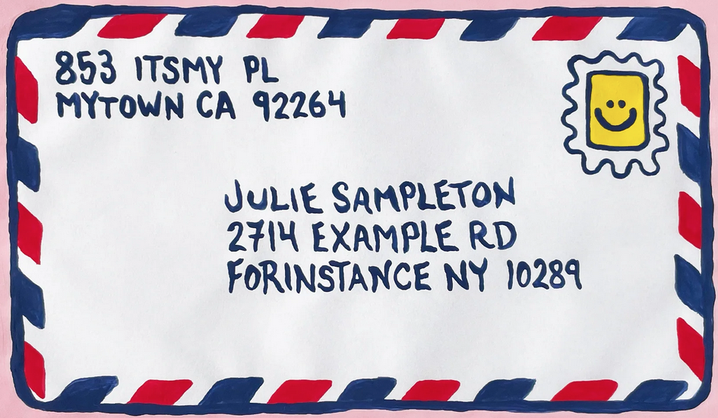
An Example: Letters
Envelope: Contains the message (Payload).
On the Envelope:
Target destination (logical)
Source location (logical)
Also on the Envelope:
Physical destination
Physical source
Borrowed from: https://nicepapergoods.com/blogs/group-hug/how-to-address-an-envelope-in-3-easy-steps

Slide 21
Letters and the OSI Model
Letters:
Layer 7: The concept.
Layer 6: The layout
Layer 5: The conversation
Layer 4: How to deliver?
Layer 3: Envelope addresses.
Layer 2: Target destination / recipient.
Layer 1: Mailbox, collect, post office.

Slide 22
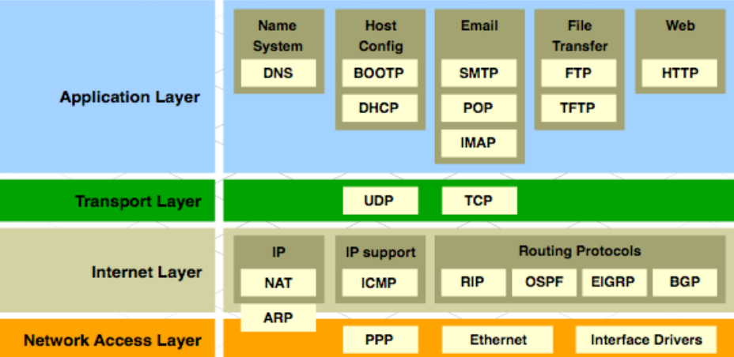
TCP/IP Protocol Suite

Slide 23
Addressing

Slide 24
(Reminder) Ports
Physical ports: The holes on a device where we connect a cable.
Logical ports: Communication identifiers for several stuff. E.g., WWW is on port 80. All application layer processes have port numbers!
Typically, ports range from 0 to 65535.
So, typically, how many ports are there available?
65536
But, why only that many? Does 65536 ring a bell?
Take into account that 65536 = 2¹⁶…
…and the fact that TCP uses 16 bits to encode port numbers, so…
…2¹⁶ = 65536 options.

Slide 25
Ports: An Example
We make an http:// requests using port “80” (so, you shouldn’t mess with this port!)
For instance, we open a web-page, say YouTube.
YouTube server’s (receiving device) ensures that it has this port open - i.e., an application is running on that port.
If there is a match, then the port number, 80, is removed from received information, and the rest is passed to the application (decapsulation).
Why do we disregard port number?
Because it is not relevant for the application, just for the server (lower level information).
This is an example of Port Addressing.

Slide 26
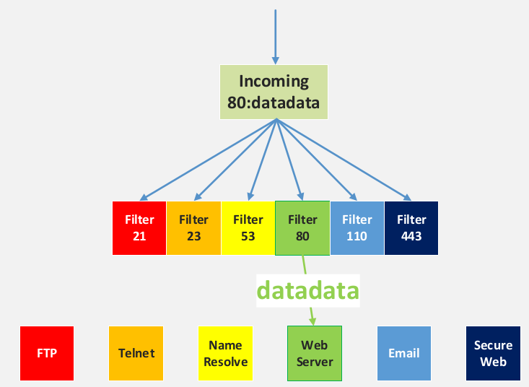
Port Addressing

Slide 27
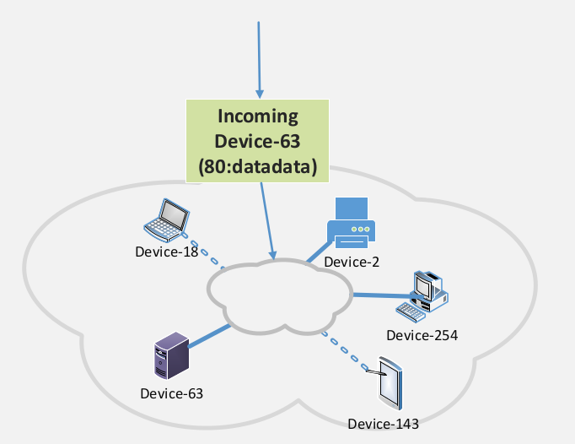
IP Addressing

Slide 28
IP Addressing
Once the target device (Device-63) in our example, we no longer need that information.
But, why?
Because we know that the correct device has received the data.
How is the process of stripping off the address of the target device in this example?
Decapsulation.
What to do with the rest of the packet?
See two slides above!

Slide 29
IP Addressing
IP addressing ensures that data are being sent to the correct device.
IP addresses are logical: They determine the network the target device lives in.
IP addresses, since they are logical, can change depending on the network you are using at each time.
Network devices also have a logical descriptor to identify that they belong to their network: the Host part of the IP address.
Delivery options:
Broadcast: Send the message to everyone, in the hope that there are suitable recipients.
Unicast: Send the message to the one correct device that knows.
Multicast: Like unicast, but for many devices (but not all).

Slide 30
Ethernet Addressing
IP Packets contain information useful to identify networks.
But, how to identify devices in that network?
You need MAC addresses!
So, you need a new “Ethernet Packet” that helps you identify devices in the network.
These are called Frames:
Frame = Packet + MAC Address.

Slide 31
(Reminder) Hubs
Unique name -> (Media Access Control) MAC Address: 12-character alphanumeric code, unique for each device in a network, e.g., 00-A1-D2-C4-55-4A.
A simply “clever” middleware could be as follows:
Simply “clever” middleware -> Hub.
Information flows towards all directions (the hub is oblivious to which is the target port / device).
Can you see the problem here?
Too many collisions (we shall cover this extensively throughout the course).
Hubs are not used anymore (really problematic).
source
C
target

Slide 32
(Reminder) Layer 2 Switches
But, why not take advantage of local connectivity?
A “really clever” middleware could take advantage of the local physical connections to direct information properly:
00-BC-11-22-A4-17:↑ 00-AA-BC-1F-DE-33:← 00-DD-DD-C6-64-4B:→ 00-32-21-98-BB-CA:↓
“Really clever” middleware -> Layer 2 switch.
Keep track of which devices (i.e., MAC addresses) are connected to which ports of C.
Essentially, memory is what makes a Layer 2 switch “really clever”.
But, what is Layer 2?
Stay tuned…
source
C
target

Slide 33
Peculiar Messaging
What if your doctor wants to share with you the following message?
My Dear, you suffer from Pneumonoultramicroscopicsilicovolcanoconiosis.
Even worse, what if you work as an actor and your director wants to share with you your new line, which reads:
Yesterday I ate an ancient Greek delicacy: λοπαδο­τεμαχο­σελαχο­γαλεο­κρανιο­λειψανο­δριμ­υπο­τριμματο­σιλφιο­καραβο­μελιτο­κατακεχυ­μενο­κιχλ­επι­κοσσυφο­φαττο­περιστερ­αλεκτρυον­οπτο­κεφαλλιο­κιγκλο­πελειο­λαγῳο­σιραιο­βαφη­τραγανο­πτερύγων [more]

Slide 34
Message Size
Message size can be a problem, thus we define maximum and minimum message sizes (a practice known as segmenting)
Why are long messages a problem?
Because they are slow to transfer, parse etc.
They limit user access.
But, why we need a minimum message size?
Because arbitrarily short messages would mean too many packets, which would mean a really busy network.
At which layer does segmentation happen?

Slide 35
Message Segmentation

Slide 36
Message Segmentation
Long messages are split into segments.
Segments are encapsulated in a packet - i.e., address information is added.
The receiver decapsulates the packets corresponding to a single long message and reassembles the original message.
Pros:
Different conversations can be interleaved (i.e., you can perplex multiple conversations simultaneously).
More reliable networks.
Con:
Complexity

Slide 37
What we saw today… 1 / n
Which are the layers of the OSI model?
The OSI model comprises of 7 layers:
Physical
Data Link
Network
Transport
Session
Presentation
Application

Slide 38
What we saw today… 2 / n
Which are the TCP/IP Conceptual layers and what is their correspondence with the OSI ones?
There are four layers:
Network Interface
Network
Transport
Application

Slide 39
What we saw today… 3 / n
What are some benefits of using models to describe networks architecture?
Some benefits include:
Global representation of multiple, highly diverse systems.
Facilitates understanding of networks and similar concepts.
The core processes are predetermined. We don’t have to worry about them (at an abstract level).
We need to take care of how information flows across layers (i.e., how the information flow across processes).

Slide 40
What we saw today… 4 / n
What is encapsulation?
Encapsulation is the process of adding information incrementally, as we move “downwards” through the layers, i.e., from the more abstract to the more lower-level layers.
What is decapsulation?
The opposite of encapsulation, i.e., moving backwards, from lower- to higher-level layers, we make use of and strip off the enabling information, thus efficiently getting back the original data.

Slide 41
What we saw today… 5 / n
Port, IP, MAC: What does each of these help us identify?
Ports help us identify the exact location from where on a network device a process is made available.
IP address helps us identify a network.
MAC address helps us identify a certain network device.
Right or Wrong? A packet contains more information than a frame.
Wrong. Frames = Packets + MAC address.

Slide 42
What we saw today… 6 / n
Right or Wrong? Packets refer to lower layer than frames.
Wrong. Frames, refer to layer 2 but packets to layer 3 - remember, frames are encapsulated packets, so we move down the layer stack!
At which layer of the OSI model do message segments live in?
At the transport layer (layer 4).

Slide 43
What we saw today… 7 / n
Name some pros and cons of message segmentation.
Pros:
Different conversations can be interleaved (i.e., you can perplex multiple conversations simultaneously).
More reliable networks.
Con:
Complexity

Slide 44
Homework
Based on today’s lecture and online (or other) resources, write a 300-400 word essay about the structure of the OSI model. Indicatively, you could cover the following among others:
When it was devised and by whom?
Which are its merits?
Which are its key components?
Why it is / isn’t useful.
Share your responses through: v.markos@mc-class.gr

Slide 45
(Reminder) NetAcad Courses
In the “Download Packet Tracer” page, above the “Download” section, you can find three interesting courses (interesting course: a course is characterised as “interesting” to inform someone that they should take it, without telling them to do so directly):
Getting Started with Cisco Packet Tracer
Exploring Networking with Cisco Packet Tracer
Exploring IoT with Cisco Packet Tracer
Also interesting is the following NetAcad course:
Network Technician

Slide 46

Any Questions?
Don’t forget to fill-in the questionnaire! (look right)
https://forms.gle/6q2tuByroaan8kWH8

